Slide 1


Causal Discovery in Text using Context and Dependency Information
SICE Annual Conference 2022
Authors: Shania Mitra, Arun Tangirala

Slide 2
Motivating Example
Subprocess-A (Reactor Temperature > liquid level)
Subprocess-B (Liquid Level > Pressure)
1 Sept
As reactor temperature increases liquid level increases
7 Sept
The reactor temperature was higher than usual.
3 Sept As liquid level increases pressure increases. High pressure causes a violent movement in the lever arm
7 Sept Liquid level rose to dangerously high levels
From these, we can predict that, pressure levels in Subprocess-B must have risen and caused a movement in the lever arm

Slide 3
Problem Statement
Analysing operator logs from processes is at a relatively nascent stage, leading to key insights and causal information being overlooked
Tagging cause and effect phrases in sentences can help build causal graphs and assist in fault diagnosis and process monitoring
MOTIVATION:
Present-day literature focuses mostly on inferring causal relationships between process variables in numerical data
Manual extraction is laborious and the complexity of natural language makes rule based systems ineffective

Slide 4
Proposed Methodology
Step 1
Step 2
Step 3
Step 4
Data Collection
Limited annotated Cause-Effect data available
Annotated Operator Logs unavailable
Preprocessing
Most available datasets contain noise
Conversion required to make textual data machine readable
Model Building
Experiment with model architectures
Feed different kinds of information about the text to the model
Model Evaluation
Evaluate performance of model
If performance unsatisfactory, repeat Step-3

Slide 5
Proposed Methodology
Step 1
Step 2
Step 3
Step 4
Data Collection
Limited annotated Cause-Effect data available
Annotated Operator Logs unavailable
Preprocessing
Most available datasets contain noise
Conversion required to make textual data machine readable
Model Building
Experiment with model architectures
Feed different kinds of information about the text to the model
Model Evaluation
Evaluate performance of model
If performance unsatisfactory, repeat Step-3

Slide 6
Proposed Methodology
Step 1
Step 2
Step 3
Step 4
Data Collection
Limited annotated Cause-Effect data available
Annotated Operator Logs unavailable
Preprocessing
Most available datasets contain noise
Conversion required to make textual data machine readable
Model Building
Experiment with model architectures
Feed different kinds of information about the text to the model
Model Evaluation
Evaluate performance of model
If performance unsatisfactory, repeat Step-3

Slide 7
Proposed Methodology
Step 1
Step 2
Step 3
Step 4
Data Collection
Limited annotated Cause-Effect data available
Annotated Operator Logs unavailable
Preprocessing
Most available datasets contain noise
Conversion required to make textual data machine readable
Model Building
Experiment with model architectures
Feed different kinds of information about the text to the model
Model Evaluation
Evaluate performance of model
If performance unsatisfactory, repeat Step-3

Slide 8
Proposed Methodology
Step 1
Step 2
Step 3
Step 4
Data Collection
Limited annotated Cause-Effect data available
Annotated Operator Logs unavailable
Preprocessing
Most available datasets contain noise
Conversion required to make textual data machine readable
Model Building
Experiment with model architectures
Feed different kinds of information about the text to the model
Model Evaluation
Evaluate performance of model
If performance unsatisfactory, repeat Step-3

Slide 9
Step-1: Data Collection
Cause Phrase
Effect Phrase
Dataset | Description | Number of sentences | Number of unique terms in Train Set | Number of unique terms in Test Set | Number of common terms in Train & Test
SemEval 2010 Task-8 | Relation Extraction data with general english sentences. Eg. The burst has been caused by the water hammer pressure | 1003 | 4804 | 1252 | 1147
BECAUSE 2.0 | Corpus with causality annotated. Eg. An American crackdown in Baghdad facilitated fighting in Basra | 1227 | 3663 | 908 | 853
CausalBank | Cause-effect statements from Common Crawl Corpus. Eg. A barbiturate is a type of medication that brings on a sense of well-being | 4000 | 9862 | 2915 | 3368

Slide 10
Step-2: Preprocessing
Linguistic Features:
Generate features for each word in a sentence
Example: Part of Speech tags, WordNet Hierarchy
GloVE Embeddings:
Models are unable to comprehend text directly
Embeddings convert words to numbers
50-dimensional embeddings used
Parse Tree generation:
Words in a sentence are related to each other
Generate a graph structure with these relationships for each sentence, where nodes are words and edges are relationships such as noun, object, verb etc.
Node2Vec Embeddings:
Generates vector embeddings for each node in the graph based on its surroundings
Preserves structure of graph
20-dimensional graph embeddings used

Slide 11
Step-2: Preprocessing
Linguistic Features:
Generate features for each word in a sentence
Example: Part of Speech tags, WordNet Hierarchy
GloVE Embeddings:
Models are unable to comprehend text directly
Embeddings convert words to numbers
50-dimensional embeddings used
Parse Tree generation:
Words in a sentence are related to each other
Generate a graph structure with these relationships for each sentence, where nodes are words and edges are relationships such as noun, object, verb etc.
Node2Vec Embeddings:
Generates vector embeddings for each node in the graph based on its surroundings
Preserves structure of graph
20-dimensional graph embeddings used

Slide 12
Step-2: Preprocessing
Linguistic Features:
Generate features for each word in a sentence
Example: Part of Speech tags, WordNet Hierarchy
GloVE Embeddings:
Models are unable to comprehend text directly
Embeddings convert words to numbers
50-dimensional embeddings used
Parse Tree generation:
Words in a sentence are related to each other
Generate a graph structure with these relationships for each sentence, where nodes are words and edges are relationships such as noun, object, verb etc.
Node2Vec Embeddings:
Generates vector embeddings for each node in the graph based on its surroundings
Preserves structure of graph
20-dimensional graph embeddings used

Slide 13
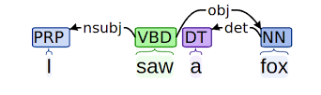
Step-2: Preprocessing
Linguistic Features:
Generate features for each word in a sentence
Example: Part of Speech tags, WordNet Hierarchy
GloVE Embeddings:
Models are unable to comprehend text directly
Embeddings convert words to numbers
50-dimensional embeddings used
Parse Tree generation:
Words in a sentence are related to each other
Generate a graph structure with these relationships for each sentence, where nodes are words and edges are relationships such as noun, object, verb etc.
Node2Vec Embeddings:
Generates vector embeddings for each node in the graph based on its surroundings
Preserves structure of graph
20-dimensional graph embeddings used

Slide 14
Step-2: Preprocessing
Linguistic Features:
Generate features for each word in a sentence
Example: Part of Speech tags, WordNet Hierarchy
GloVE Embeddings:
Models are unable to comprehend text directly
Embeddings convert words to numbers
50-dimensional embeddings used
Parse Tree generation:
Words in a sentence are related to each other
Generate a graph structure with these relationships for each sentence, where nodes are words and edges are relationships such as noun, object, verb etc.
Node2Vec Embeddings:
Generates vector embeddings for each node in the graph based on its surroundings
Preserves structure of graph
20-dimensional graph embeddings used

Slide 15
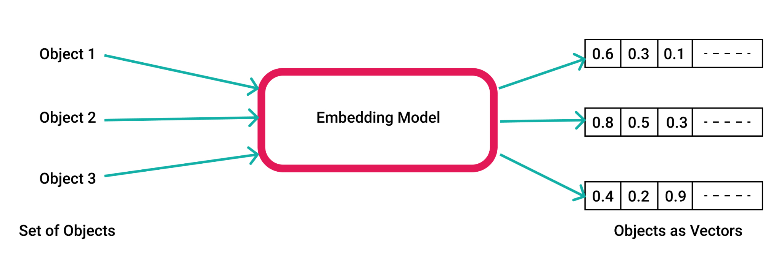
What is an Embedding?
A method/model to convert words to numbers which are understood by models is called an embedding
Source: Google Images

Slide 16
Step-3: Model Building
Causal Tagging System
Context Information
Linguistic Information
Dependency Information
Used in Existing Literature
Introduced via this work
Example Sentence: Rita loves to eat icecream with chocolate chips.
Icecream

Slide 17
Step-3: Model Building
Causal Tagging System
Context Information
Linguistic Information
Dependency Information
Used in Existing Literature
Introduced via this work
Example Sentence: Rita loves to eat icecream with chocolate chips.
Icecream

Slide 18
Step-3: Model Building
Causal Tagging System
Context Information
Linguistic Information
Dependency Information
Used in Existing Literature
Introduced via this work
Example Sentence: Rita loves to eat icecream with chocolate chips.
Icecream

Slide 19
Step-3: Model Building
Causal Tagging System
Context Information
Linguistic Information
Dependency Information
Used in Existing Literature
Introduced via this work
Example Sentence: Rita loves to eat icecream with chocolate chips.
Icecream

Slide 20
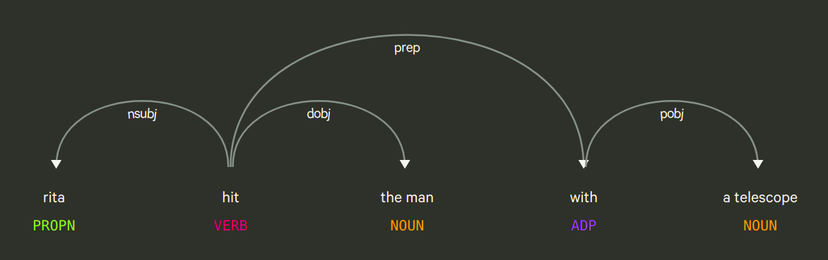
Why can we not use one component alone?
The same sentence may have multiple interpretations. In such cases the linguistic features would remain the same and only the parse trees would help differentiate between the cases

Slide 21
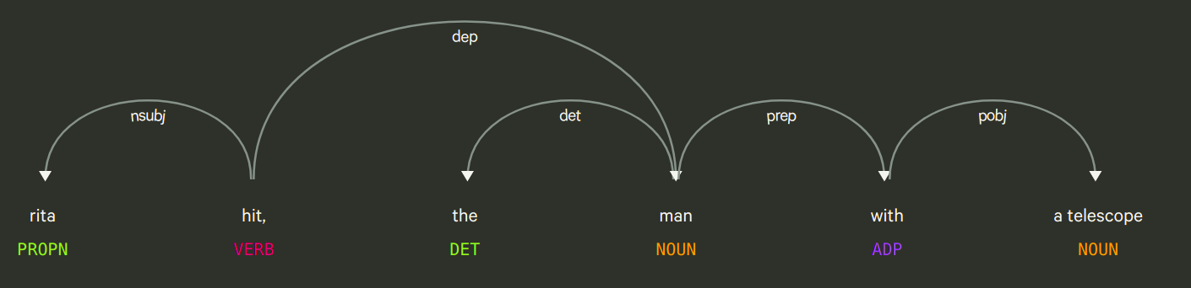
Example Continued
Interpretation-1: Rita hit the man using a telescope
Interpretation-2: Rita hit the man who had a telescope

Slide 22
Proposed Pipeline
Textual Sequences (B x 60)
One-hot encoded Linguistic Features (B * 60 * 145)
Dependency Graph
Glove Embeddings
(B * 60 * 50)
Node2Vec
(B * 60 * 20)
BiLSTM
Dense Layer with NUM TAGS + 1 cells
Output: (B * 60 * 4)
*B = Batch Size

Slide 23
Step-4: Experiments and Testing
To test importance of each component, 4 models created: CRF (Baseline), L (Linguistic features only), D (Dependency features only), LD (proposed model)
Trained and tuned model using 5-fold cross validation on 80% of each dataset
Test on 20% of dataset held out
Metrics used for evaluation: F1-score, recall, precision, accuracy
Predicted on pipeline hazard operator logs (PHMSA Dataset)

Slide 24
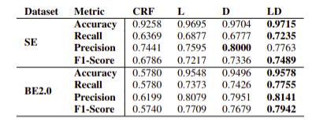
Results
Proposed Method BILSTM-LD has the highest F1-Score

Slide 25

Results
A sharp pressure pill-down resulted from the startup of a power plant engine.
The pressure pill-down led to violent lever arm movement of the regulator and the subsequent dropping of the weights.
This lever arm movement led to the closing of the regulator valves.
Cause
Effect
Causal Connective

Slide 26
Conclusions and Future Directions
Presented a novel algorithm for extracting causal information from textual data using context and dependency information
Context helps the model in understanding the sentence as a sequence of words
As part of this work, we novelly introduce dependency information, which helps relate different parts of a sentence
Together they help in making the model more robust, outperforming the baseline by 10.3% in SemEval and 38.6% in BECAUSE
Next Steps: Approach could be extended to large datasets of annotated operator logs and detecting causality across multiple sentences

Slide 27
THANK YOU

Slide 28
Example
Dependency Parse Tree
Example Sentence: The doll, that fell, broke
The
Context
Linguistic Features
Determiner
Doll
t=0
M O D E L
Word | PoS Tag | Hierarchy | ... | Named Entity?
The | Det | - | … | N
Doll | Noun | Artifact | … | N
That | Pron | - | … | N
Fell | Verb | Contact | … | N
Broke | Verb | Contact | … | N
The
Clause Modifier
That
t=1
Doll
Subject
Subject
t=2
That
Fell
t=3
Fell
t=4
Broke
Broke

Slide 29
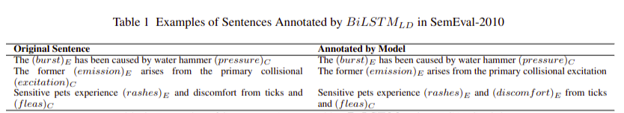
Case Study 1: SemEval 2010 Task 8
Corpus consists of 1003 Cause-Effect sentences
Cause/effect tags provided with the dataset annotate single words as cause and effect
the tags of interest in this dataset are C, E, O (no causal connective)
BiLSTM-LD outperforms on all metrics except precision, where BILSTM-D does better
Thus, dependency information contributes more than context information

Slide 30
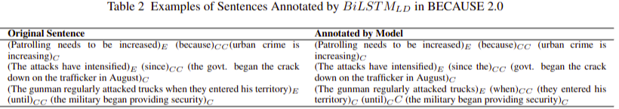
Case Study 2: BECAUSE 2.0
Corpus consists of 1727 sentence
Tags of interest: C, E, O and CC
Model is able to detect multiple levels of causality, unconventional causal connectives
Thus, the model is not learning specific word-based patterns from the training set; decides on a sentence-to-sentence basis

Slide 31
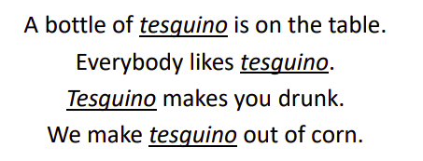
Importance of Context
Even if we do not know the meaning of the word tesguino, we can infer the meaning from the context words

Slide 32
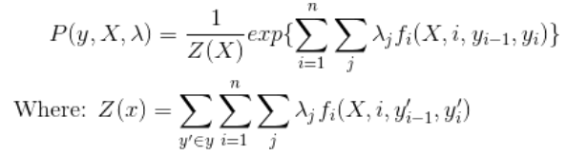
Conditional Random Field
Statistical sequence model
Input data is sequential, and we have to take previous context into account when making predictions on a data point
CRFs define a feature function f(X, i, l(i-1), l(i))
Indicator variable defined for combinations of adjacent labels
Parameters lamda are estimated using gradient descent and outputs P(y, X)

Slide 33
Node2Vec
Unsupervised algorithm that provides low-dimensional vector representations of each word in a graph
Attempts to preserve structure of graph – “similar” nodes get “similar” vectors
Based on biased random walks; algorithm explores different neighbourhoods in graph
Structural similarity of nodes is gauged based on degree and type of connectivity
https://memgraph.com/blog/how-node2vec-works

Slide 34
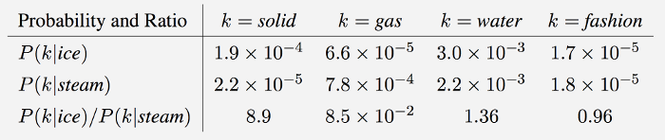
GloVE
Unsupervised learning algorithm to obtain vectors for words
Vectors representative of meaning
Takes into account local information such as surrounding words and global information such as a word-word co-occurrence matrix
Ratios of word word co-occurrence probabilities can encode some meaning

Slide 35
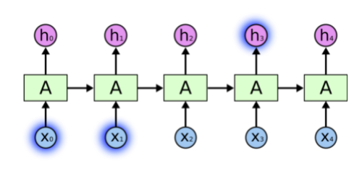
BiLSTM
Recurrent Neural Networks (RNNs) can process short sequences; learn dependencies among the current input and previous time step
LSTMs are special RNNs that are able to learn long-range relationships in sequences
In these representations will depend only on words that come before a word
BiLSTMs make use of forward and backward context making representations more meaningful

Slide 36




Metrics

